Slide 1
03 | Managing the database and making queries
Jeffrey Snover | Distinguished Engineer & Lead Architect
Jason Helmick | Senior Technologist, Concentrated Technology

Slide 2
Module Overview
Getting the database ready
Creating and updating data
Querying data

Slide 3
Getting the database ready

Slide 4
Wait - what database is Django going to use?
Whatever database you specify in the settings.py file
Supported databases include
SQLite
MySQL
Microsoft SQL Server
SQLite is the default development database for Django projects in Visual Studio

Slide 5
What is SQLite?
As the name implies, SQLite is a lightweight relational database
It’s open source and perfect for development

Slide 6
How do we create the database?
Databases used by the Django ORM are managed by migrations
Three main commands
makemigrations
Create a new migration, which contains all of the changes to be made to the database
sqlmigrate
Display the SQL statements to be used by a migration
migrate
Update the database

Slide 7
makemigrations parameters
--name
Name of the migration
Name_of_the_app
app by default

Slide 8
How do we execute these commands?
Django provides a manage.py script file to be used for managing the database
Must be executed from the command line
Visual Studio uses an older syntax

Slide 9
Creating and executing a migration
Notes:
Right click on the project, choose Open Command Prompt Here…

Slide 10
Creating and updating data

Slide 11
If you know how to create an object in Python…
You already know how to create and save objects into the database using Django
The save method is added by inheriting from Model
newArtist = Artist(name = 'Artist Name', year_formed = 2015);
newArtist.save();

Slide 12
And if you know how to modify objects in Python…
You know how to update the object in the database
The Python ORM automatically tracks changes to the object
All you need to do is update the object, and call save()
newArtist.name = 'Updated Name';
newArtist.save();

Slide 13
Creating and saving objects using Django ORM

Slide 14
Querying data

Slide 15
Django has great support for querying data
Basically, however you need to go get the data there's a way to write the query using Django ORM
Queries are created by using the objects collection
objects is added to each class that inherits from Model

Slide 16
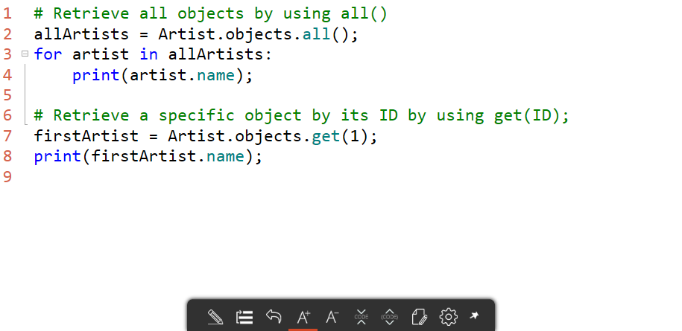
Basic queries

Slide 17
Basic queries

Slide 18
Custom queries
Django provides two main methods for writing queries
get
Returns one and only one object
If your query returns zero or more than one, an error is thrown
filter
Returns multiple objects
Technically a QuerySet, allowing for more complex queries

Slide 19
Basic filter syntax
Django is aware of your object structure, meaning you can query data using the class structure you created
Let's say you wanted to find an artist by its name:
Note: get works in our model because it would only return one artist
artist = Artist.objects.get(name = 'Artist Name');

Slide 20
How about starts with?
Often users want to write our a query where they only know part of the name, typically the beginning
To write this type of query, use property__startswith
artists = Artist.objects.filter(name__startswith = 'Great');
That's TWO underscores!

Slide 21
What about case sensitivity?
By default, queries are case sensitive
All operators are available with an insensitive variant
Simply put the letter i at the beginning
artists = Artist.objects.filter(name__istartswith = 'Great');

Slide 22
What about case sensitivity with an exact match?
Remember get?
Get is designed to only return one object
get always expects an exact match
The above query is the same as the one below
artist = Artist.objects.get(name = 'Artist Name');
artist = Artist.objects.get(name__exact = 'Artist Name');

Slide 23
So how do we make it case insensitive?
In order to make a query case insensitive, you need to use the explicit exact operator, and add the letter I
artist = Artist.objects.get(name__iexact = 'Artist Name');

Slide 24
Queries

Slide 25
What happens if I want to load all albums by an artist?
Django allows you to walk the object chain
Create your filter by using object__property
Album
name
Artist
name
1
*
albums = Album.objects.filter(artist__name = 'Artist Name');

Slide 26
Walking the object chain

